Slide 1
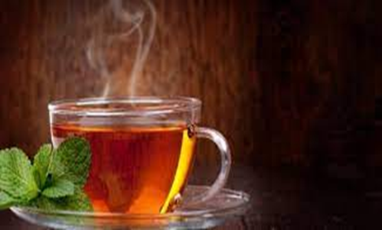
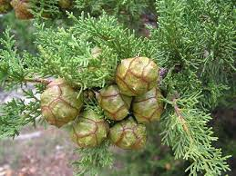
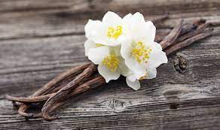
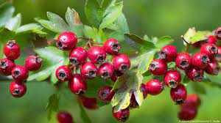
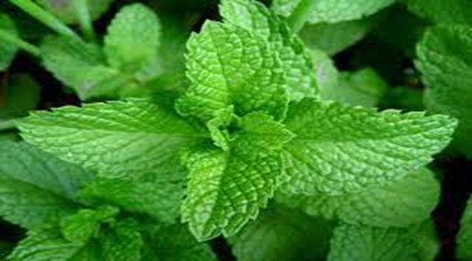
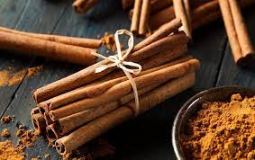
tanins
Assistant lecturer
Ola Alsaad

Slide 2
Tannins
Secondary metabolite Products , naturally occurring complex organic compounds. Nitrogen-free polyphenols with high molecular weight.
Precipitation of proteins and alkaloids. The property of tannins as an astringent is due to their ability to precipitate proteins and make them resistant for enzymatic attack.

Slide 3
Properties of tannins
Soluble in water (except for some highweight structures molecular), alcohols, dilute alkalis, and glycerin.
Insoluble in organic solvents, except acetone, slightly soluble in ethyl acetate.
It tastes bitter if the tannin content is high .
Color is yellowish white to brown .
High molecular weight ranges from 500 to >5,000 mw.
Form a non-crystallizable colloidal solution with water which leads to acidic reactions.
It has an astringent property and astringent taste in the mouth.

Slide 5
Classification of tannins
Tannin compounds can be divided into two main groups based on the Goldbeater skin test :
1- True tannins : A group of tannins that show a positive Goldbeater skin test , high molecular weight(>500mw).
2- Pseudo-tannins :They are simple phenolic compounds with lower molecular weight(<500mw).It does not respond to the tanning reaction of the Goldbeater skin test.
Examples: Cocoa , Coffee .

Slide 7
Classification of tannins
Tannins can be divided into two main groups based on the chemical structure and hydrolytic reaction :
1- Hydrolysable tannins : They are ester of sugar and variable number of phenolic acid, they are hydrolysed by acids or enzyme , and produced Gallic acid and ellagic acid, soluble in water and their solution produces a blue color with ferric chloride.
Examples: pomegranate , eucalyptus .
2- Condensed or Nonhydrolysable tannins : They are not readily hydrolysable in to simpler molecules , not contain sugar moity ,polymeric flvans , condensed tannins are also soluble in water and produce a green color with ferric chloride.
Examples: Kola , Green tea .

Slide 9
Medicinal properties and uses
Astringent for burns and inflammation of mucous membranes.
Antioxidant, antibacterial, antifungal , anticancer .
Tannins are used to treat skin ulcers, hemorrhoids, frostbite, as well as inflammation of gums.
Stomach stimulant, blood thinner, diuretic.
Sore throat, diarrhea, dysentery .
Treatment for bee sting venom.
Control gastroenteritis, and in cases of heavy metal poisoning as an antidot.
In recent years, these compounds have proven their antiviral activity in treating viral diseases, including... AIDS.

Slide 10
Other uses of tannins
It is used in the leather tanning process.
Protect plants from herbivores.
Protect plants from microbial attacks.
Tannins are used as an adhesive in dyeing, ink making, silk.
Tannins are also used in photography, and as a coagulant in the rubber industry.
Detector in laboratories.

Slide 11
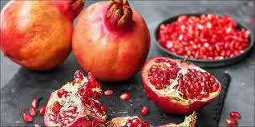
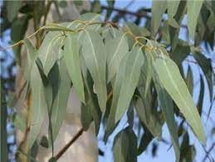
Tanins example
Pomegranate
S.name : Punica granatum
Family: Punicaceae
active part : Peels
Eucalyptus
S.name:Eucalyptus camaldulenses
Family : Myrtaceae
active part : Leaves and bark

Slide 12
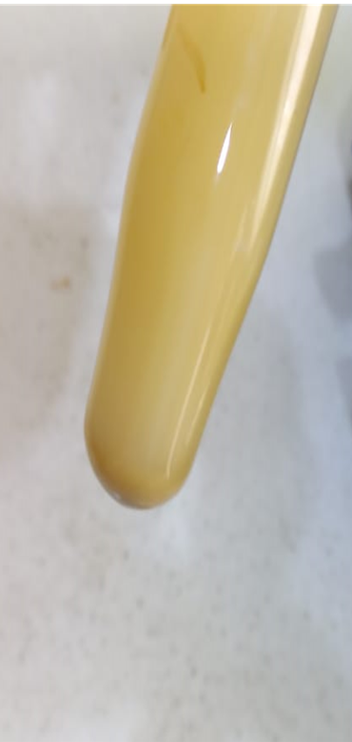
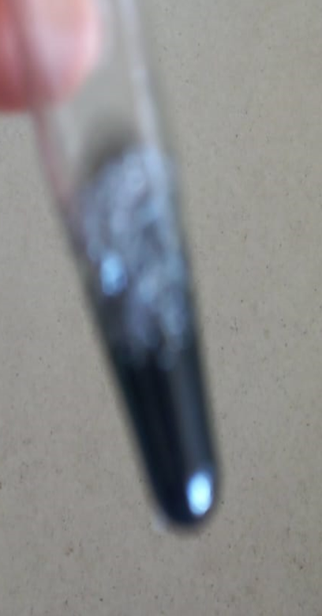
The procedure
Prepare plant extract : 1gm of plant in 200ml D.W (decoction method).
1- gelatin test : 1 ml of the extracts mixed with few drops of 1% gelatin solution ; the mixture gives white precipitate , (gelatin is protein).
2- Lead acetate tests: 1ml of extracts mixed with few drops 10% lead acetate ; the mixture gives white precipitate.
3-Ferric chloride (FeCl3) tests (Hydrolyzable tannins): 1ml of the extracts mixed with few drops of 5% Ferric chloride the mixture gives blue to black color.

Slide 13
Thank you

